Slide 1
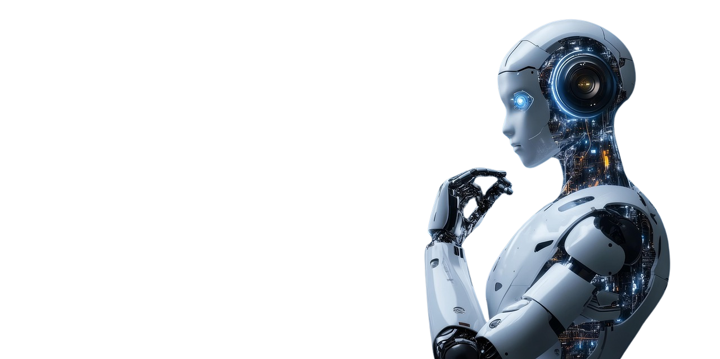
Introduction to Generative AI

Slide 2
Table of Content
1
2
3
4
5
6
7
What is AI
Generative AI
How does AI develop creativity
Evolution of AI
Capabilities of AI
Applications
Applications using python

Slide 3
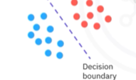
WHAT IS ARTIFICIAL INTELLIGENCE
Learns from massive existing data through training
DISCRIMINATIVE AI
Discriminative AI model is given a set of training data, where each data point is labelled. The model then predicts the class of a new data point by finding the side of the decision boundary that the data point falls on.
Use Advance algorithms to
Differentiate
Classify
Identify patterns
Draw Conclusion
Eg.Spam filters
Limitations
Cannot understand context
Cannot generate new context

Slide 4
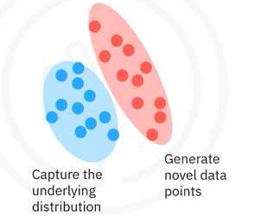
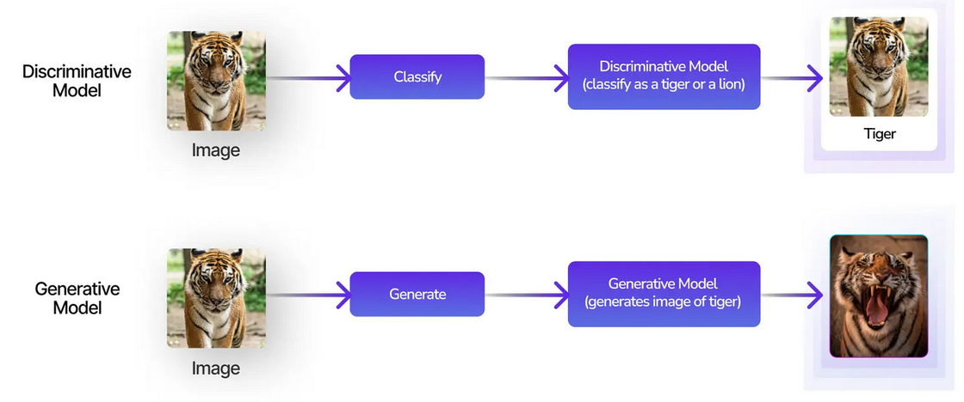
GENERATIVE AI
Create new content based on the training data
Output
Text
Image
Audio
Video
Code
Data
Prompt
Text
Image
Video
Other forms of Input

Slide 5
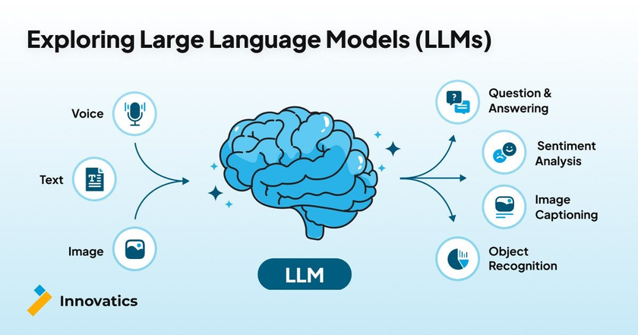
HOW DOES GENERATIVE AI DEVELOP CREATIVITY
Creative skills through generative ai models
Generative adversial networks (GANS)
Variational Autoencoders(VAES)
Transformers
Diffusion Models
FOUNDATIONAL MODELS
AI models with broad capabilities
Adapted to build specialized and advances models or tools
Large Language Models :Process and generate text
Eg of LLMS : Open AI :GPT SERIES , Google: PaLM,Meta: Llama
Eg of models for image generation :Stable diffusion ,DALL-E

Slide 6
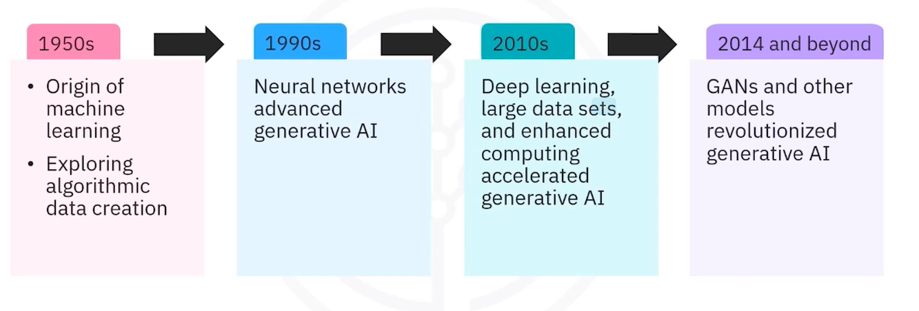
EVOLUTION OF AI

Slide 7
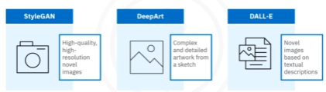
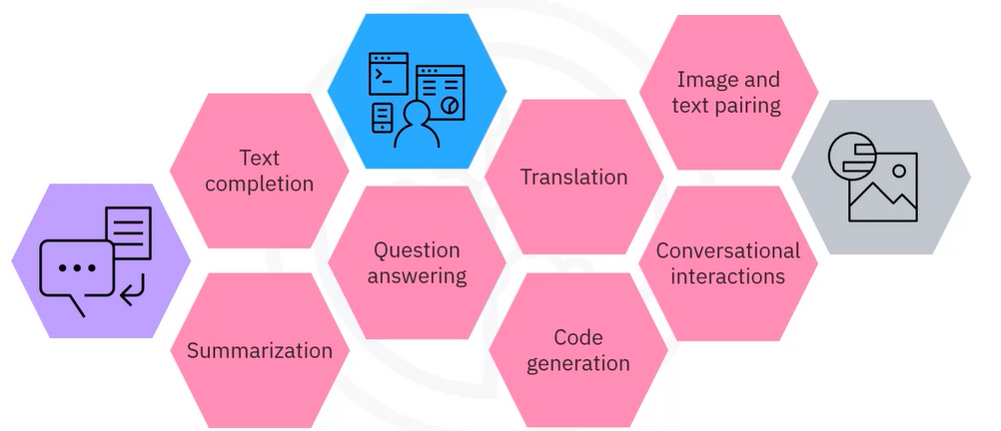
CAPABILITIES OF GENERATIVE AI
Text Generation –LLM
Trained on large data sets
Generates human like text in various contexts
Learn patterns and structures from data sets
Generate coherent and contextually relevant responses, text or response, conversation ,summary, explainations
eg - open AI GPTs ,googles PaLM
Image generation
Gen AI models leverage deep learning techniques :
GAN
VAEs
It inhibits realistic textures ,natural colors and fine grained details
used in art ,entertainment, design, gaming, research, medical imaging and scientific visualization

Slide 8
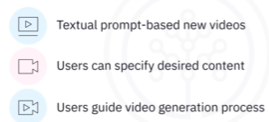
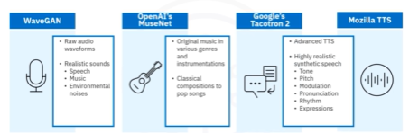
CAPABILITIES OF GENERATIVE AI
Audio Generation
Musical composition
Text to speech
Synthetic voices
natural sounding speech
used in media,creativity,entertainment
training and education ,gaming
Video Generation
Create basic animations to complex scenes
transform images into dynamic videos
exhibit smooth motion and transitions

Slide 9
CAPABILTIES OF GEN AI
Code Generation
Code snippets
Functions
Complete Programs
Can complete or create code,
Synthesize or refract code, identify and fix bugs in code, test software, and create documentation including comments, function descriptions
Eg-Github Copilot and watson code assistant
Data Augmentation and Generation
These models can generate new samples and augment data sets
Generating synthetic data sets helps increase the diversity and
variability of the data, leading to more robust and effective performance.
Applications in medicine, healthcare, gaming, education and training,
Virtual World
You can also create complex virtual environments with realistic textures,
You can create avatars that simulate realistic behavior,virtual identities with unique personalities

Slide 10
APPLICATIONS
IT and DevOps- include code generation, code reviews, automated testing, monitoring and anomaly detection, automated documentation, and the continuous integration and deployment process.
Entertainment- generating a variety of synthetic content and translating, localizing, and personalizing content.
Education- transforms the reach and quality of education affecting learners, educators, and educational technologies.
Finance- risk assessment, credit scoring, sentiment analysis, portfolio management, compliance, forecasting, trading, and customer care.
Medicine and healthcare-medical research, diagnostics, medicine, medical training, and patient care.
HR- talent acquisition, employee engagement, performance management, training and development, HR analytics, and policy implementation.

Slide 11
APPLICATIONS USING PYTHON
BUSSINESS AI COMPANION -creating an app that captures audio using OpenAI Whisper and summarize it using Llama 2 LLM
https://drive.google.com/file/d/1e_tuoIujZf17C_8BTmGTZ5fv9G8PX2AM/view?usp=sharing
CHATBOT USING BLENDERBOT-creating a simple chatbot using Facebook’s Blenderbot model and Hugging Face’s Python library, Transformers
https://drive.google.com/file/d/11tf555h1GqO3gw0SBQk9CXcoJJ5GB7NQ/view?usp=sharing
IMAGE CAPTIONING-an image captioning tool using the BLIP model from Hugging Face’s Transformers.
https://drive.google.com/file/d/1x5Z4sZ85baDqMquNkcU9ixc28yMOo9Er/view?usp=sharing
FINAL LAB -Testing all the capabilities of gen ai
https://drive.google.com/file/d/1F65M6wI74w9VP_ayrE79SfewLQ6cxcd1/view?usp=sharing

